Slide 1
Pizza Ordering and Management System
Moeez Khan

Slide 2
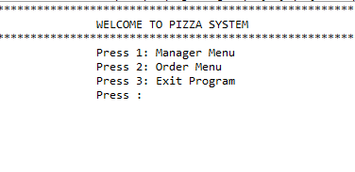



Main Menu
Main Menu
Manager
Menu
Exit
Order
Menu

Slide 3

Main Menu

Slide 4
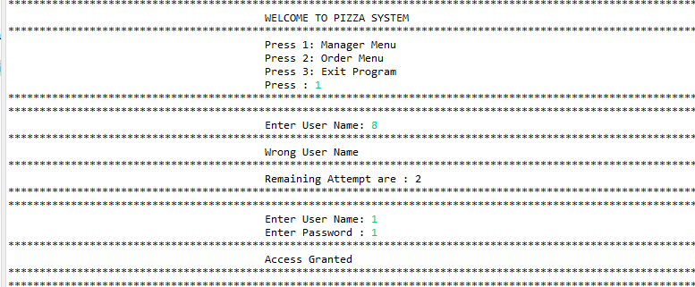

Login Page
Login
Page
If more attempts than three

Slide 5
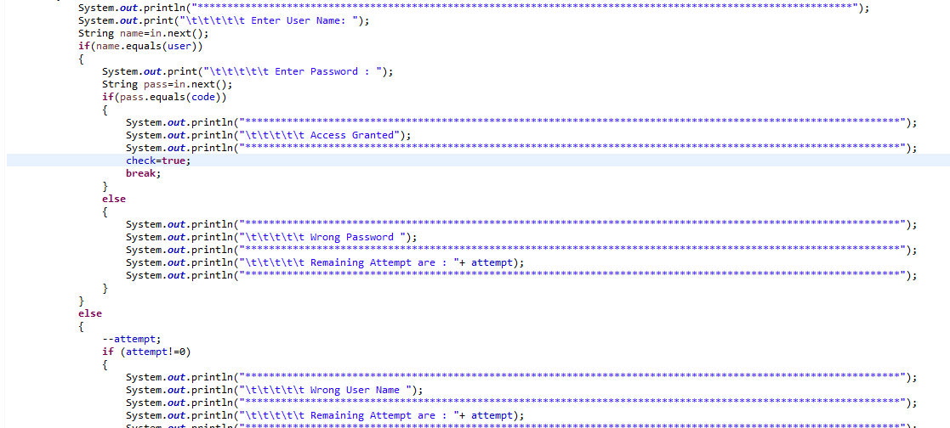
Login

Slide 6

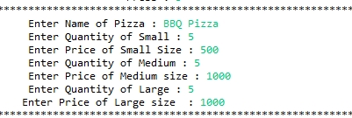




Manager Menu
03
2
3
4
04
01
02
05

Slide 7
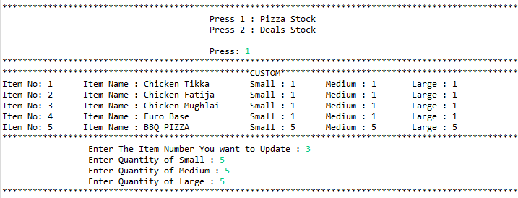
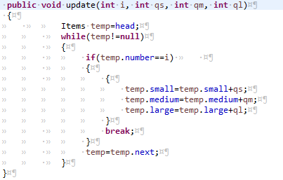

1) Update : Pizza Stock
CODE

Slide 8
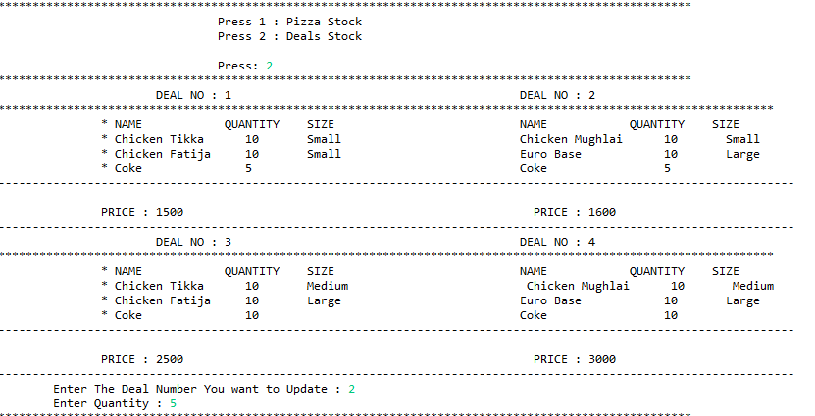
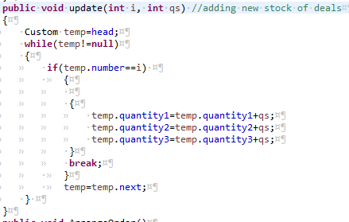
1) Update: Deal Stock
CODE

Slide 9

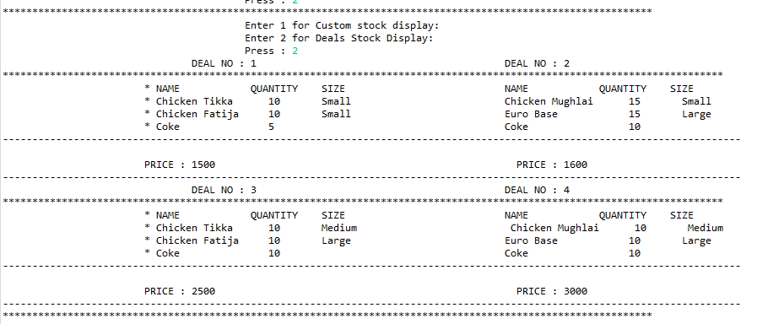
2) Checking Stock After Update
Custom Stock Display
Deals Stock Display

Slide 10

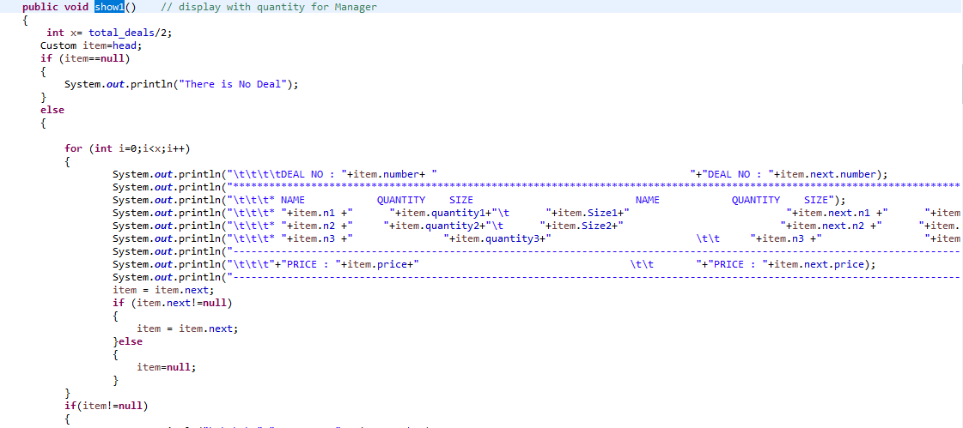
Checking Stock

Slide 11


4) Deletion Of Custom Item
Display After Deletion

Slide 12
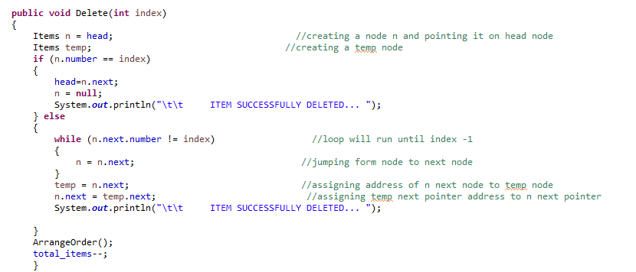
Code Of Deleting Custom

Slide 13


5) Total sales
Before Ordering
After Ordering

Slide 14

Total sales

Slide 15
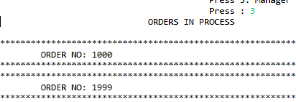


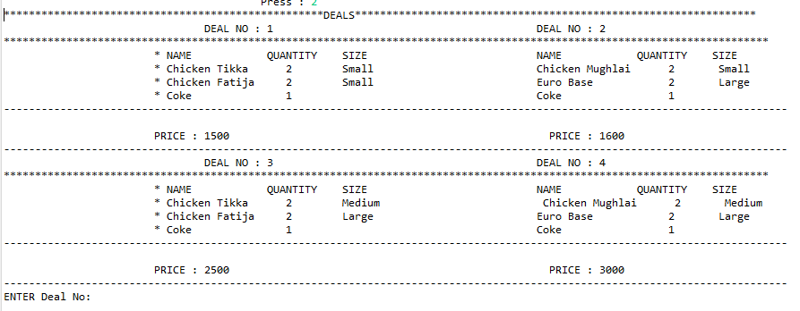

Ordering Menu
03
01
04
02

Slide 16
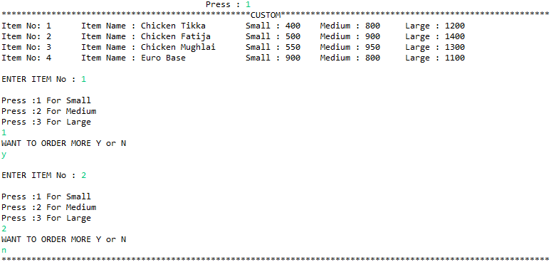
1) Custom Order

Slide 17
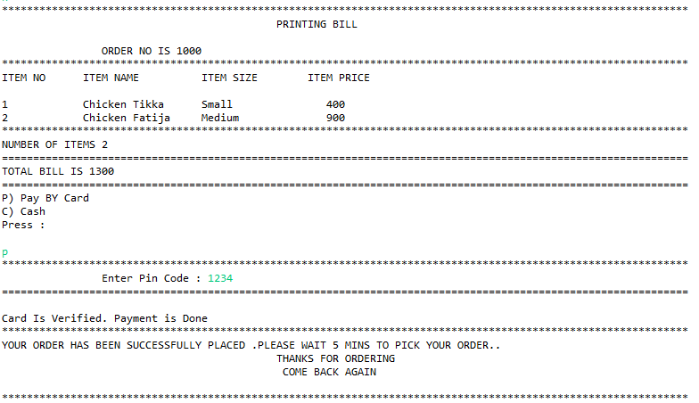
Custom Order

Slide 18
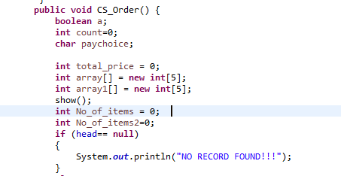
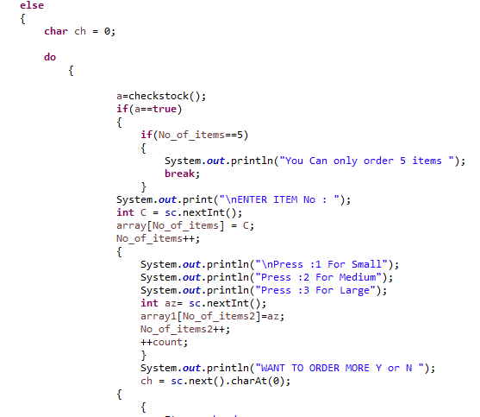
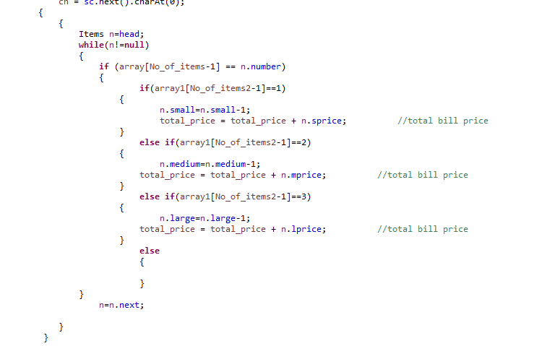
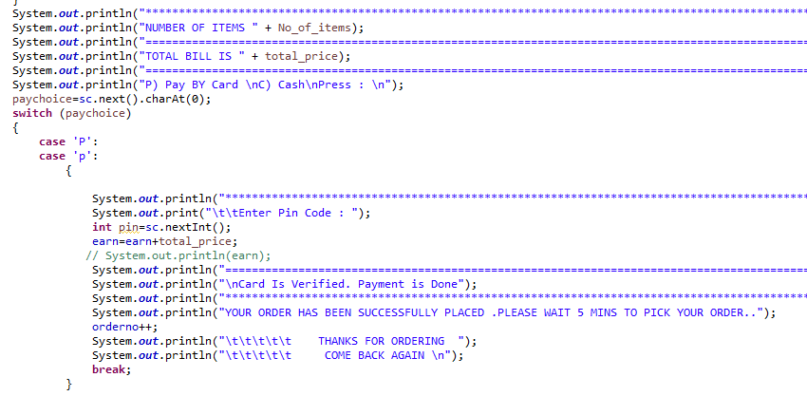
Custom Order

Slide 19
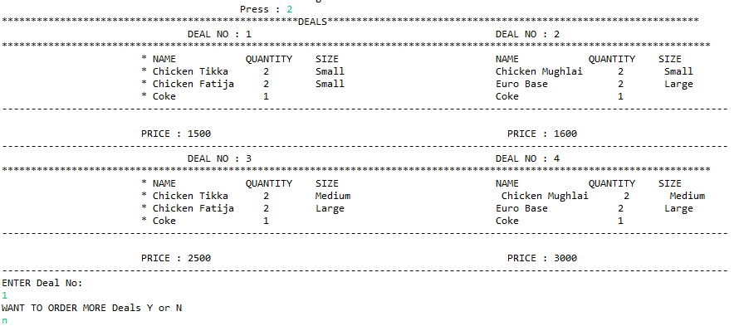
2) Deal Order

Slide 20
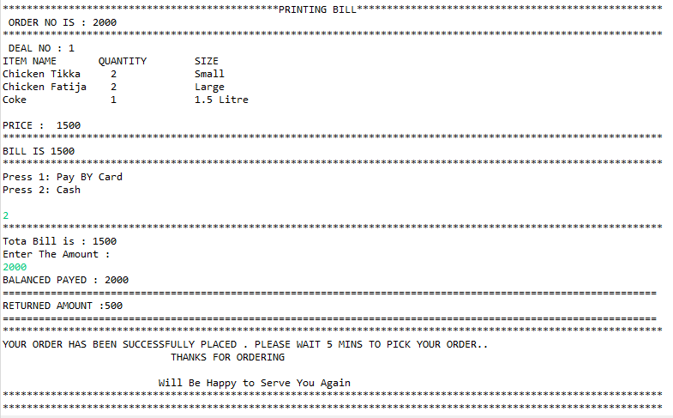
Deal Order

Slide 21
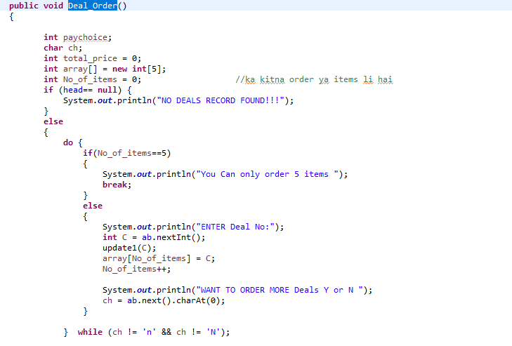
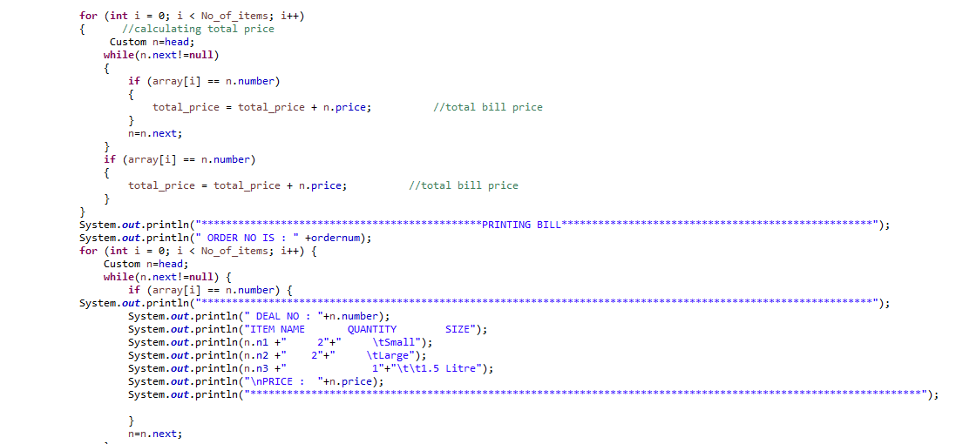
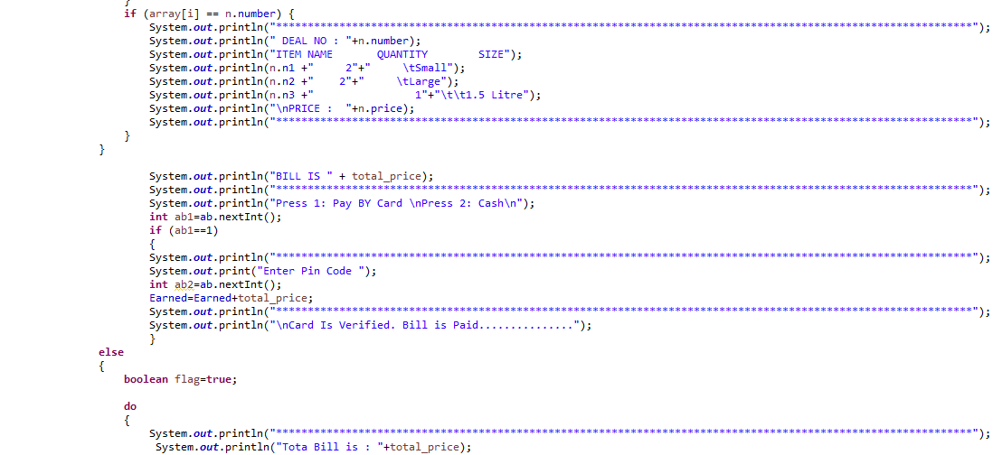
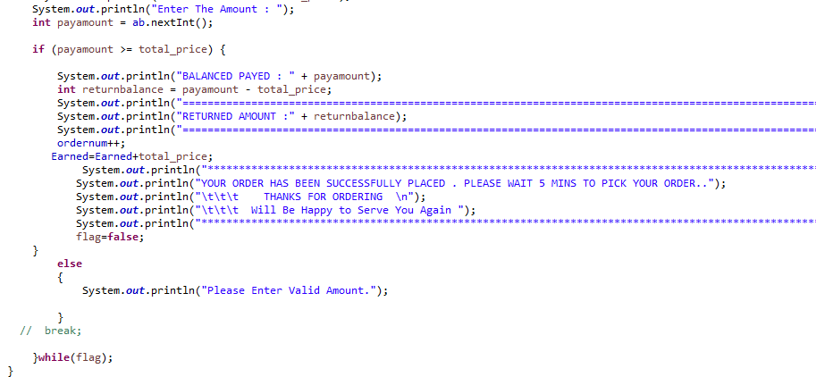
Deal Order

Slide 22


3) Orders In Process…
Code

Slide 23


4) Pick Up Your Order
Code

Slide 24

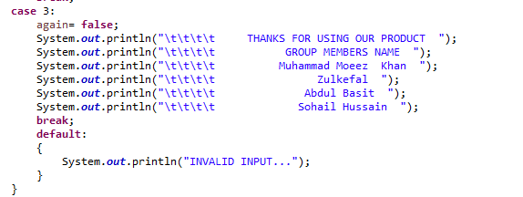
3) Exiting
Code

Slide 25

Any Questions ?

Slide 26


